Slide 1
CAUTI Reduction Portfolio

Slide 2
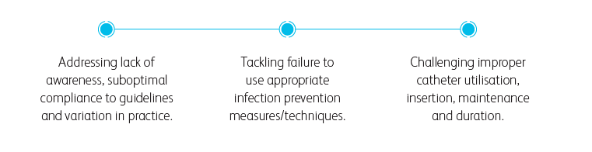
Infection Prevention

Slide 3
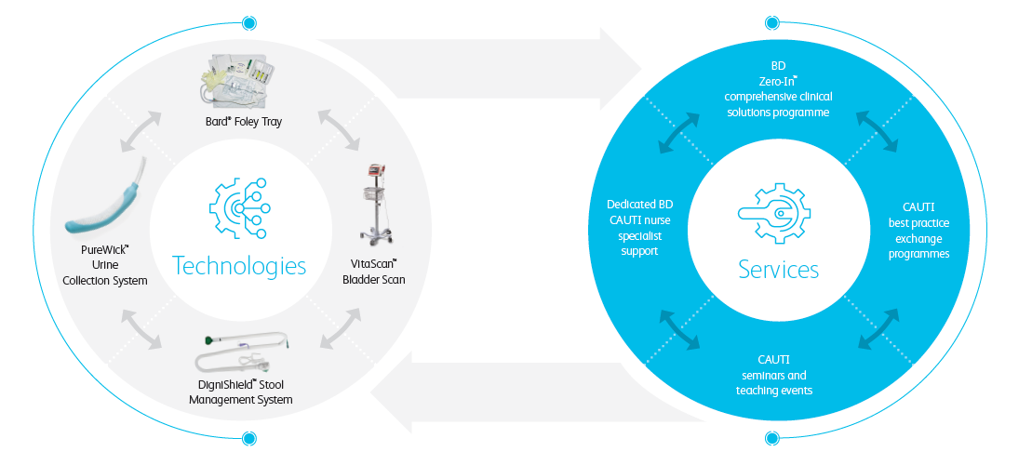
Infection Prevention

Slide 4
Infection Prevention

Slide 5
Infection Prevention

Slide 6

Zero – In

Slide 7
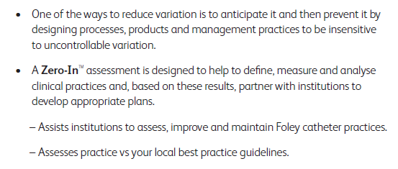
Zero – In

Slide 8

Zero – In

Slide 9
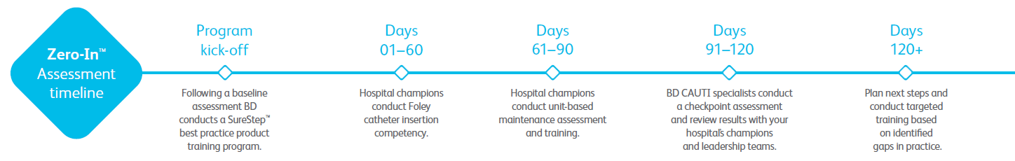
Zero – In

Slide 10

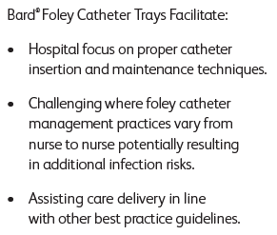
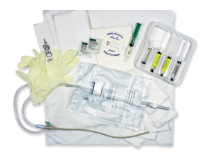
Bard Foley Catheter Trays

Slide 11
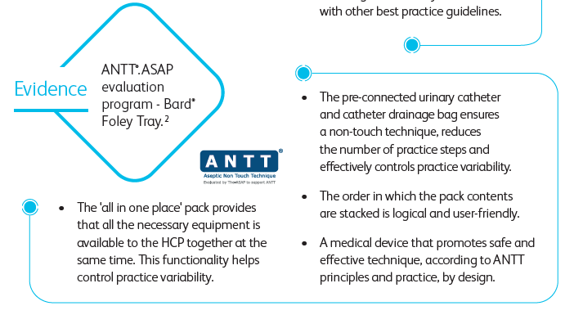
Bard Foley Catheter Trays – Evidence

Slide 12
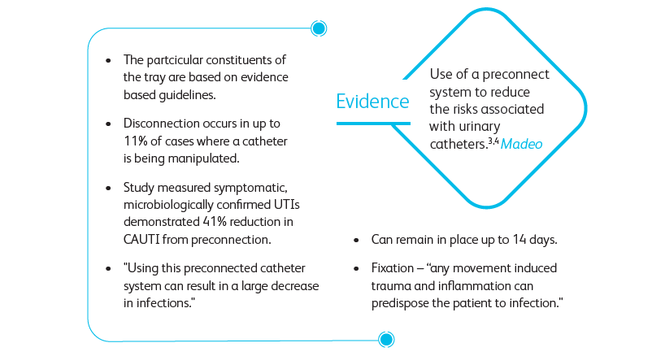
Bard Foley Catheter Trays – Evidence

Slide 13
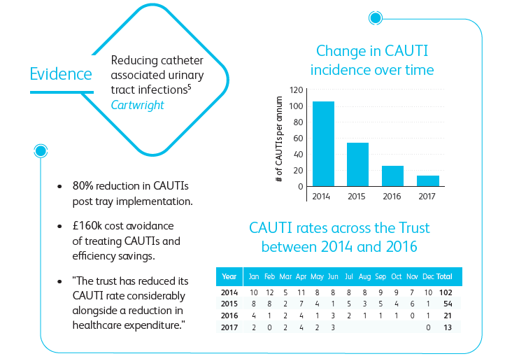
Bard Foley Catheter Trays – Evidence

Slide 14
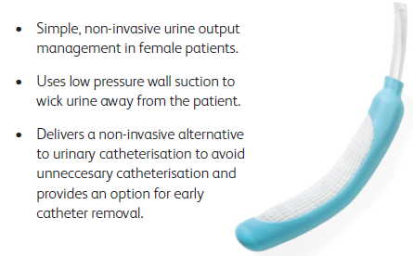
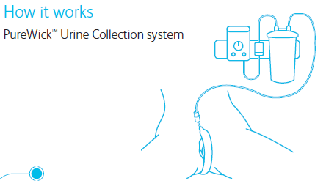
PureWick Urine Collection System

Slide 15
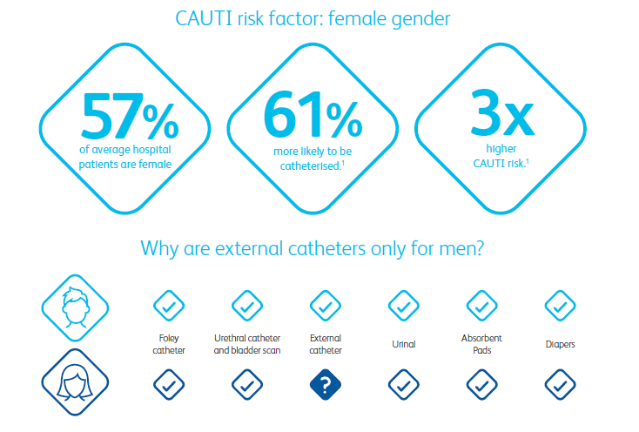
PureWick Urine Collection System

Slide 16
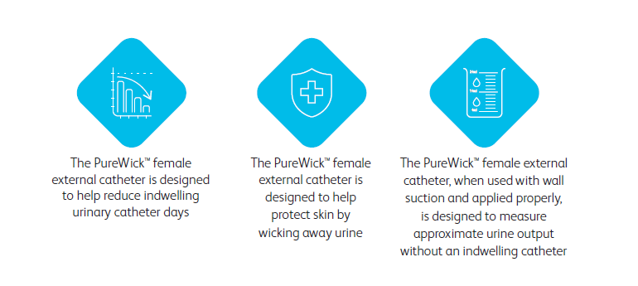
PureWick Urine Collection System

Slide 17
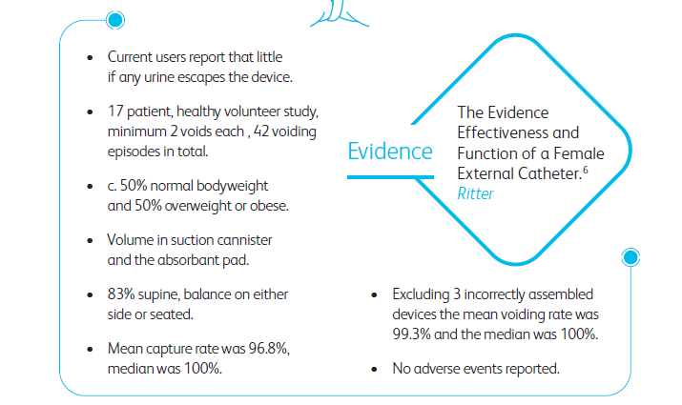
PureWick Urine Collection System – Evidence

Slide 18
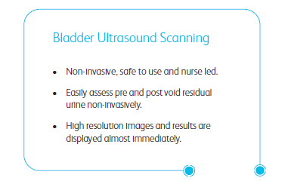
Vitascan PD+

Slide 19
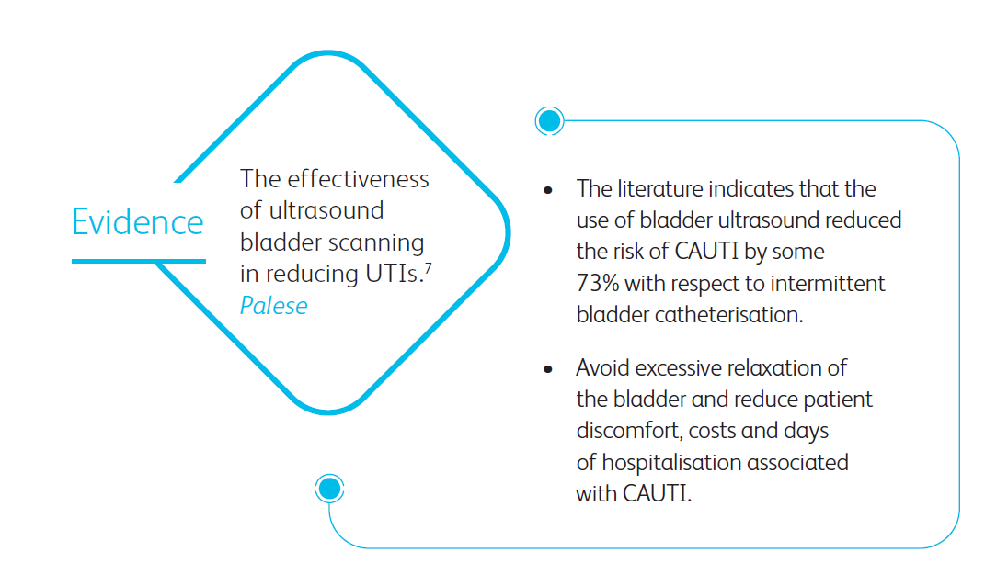
Vitascan PD+ Evidence

Slide 20
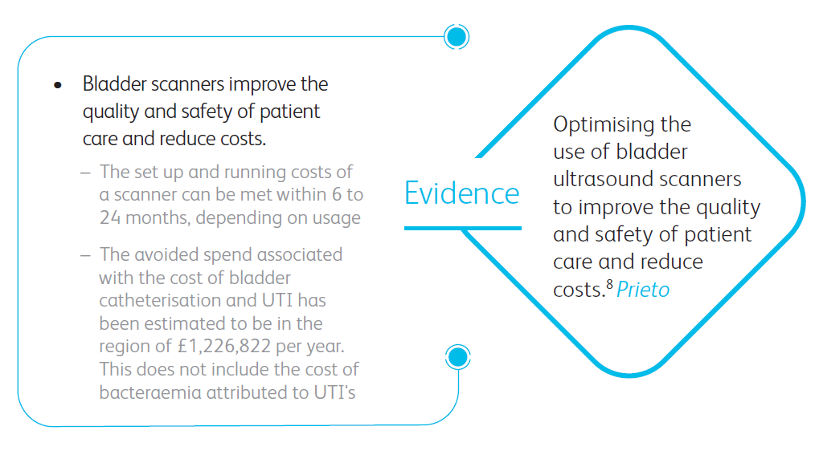
Vitascan PD+ Evidence

Slide 21
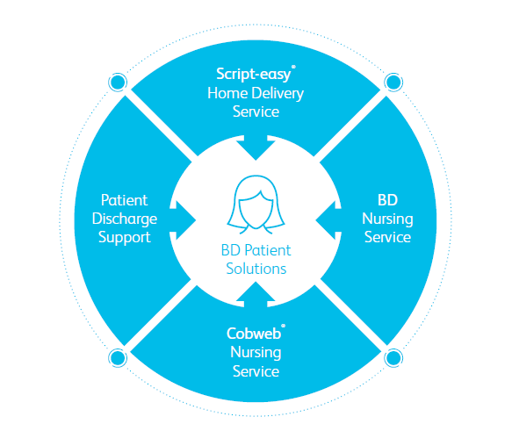
Continuity Of Care

Slide 22
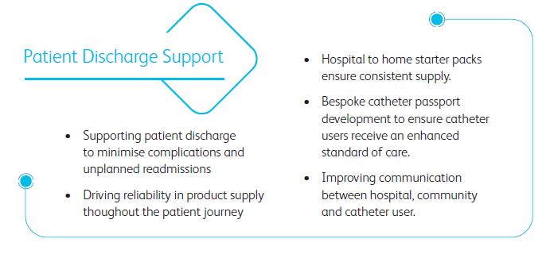

Continuity Of Care

Slide 23

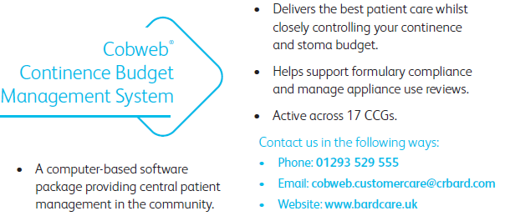
Continuity Of Care

Slide 24
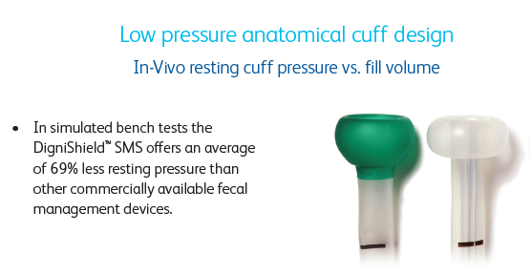
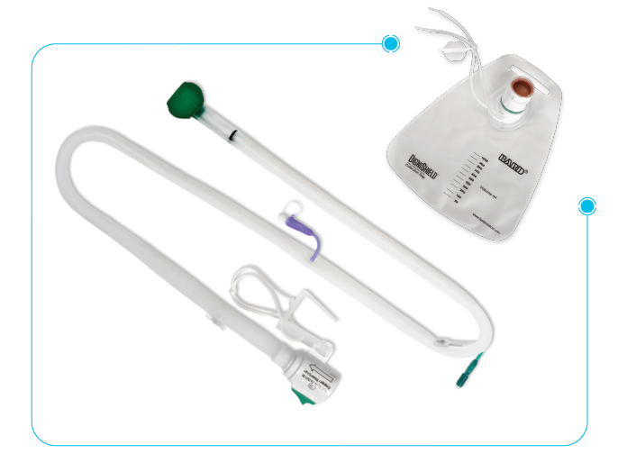
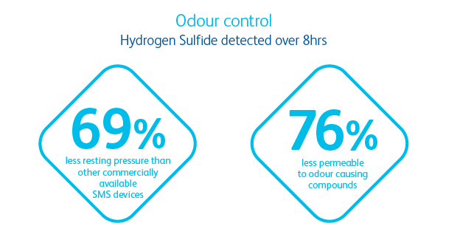
DigniShield Stool Management System

Slide 25
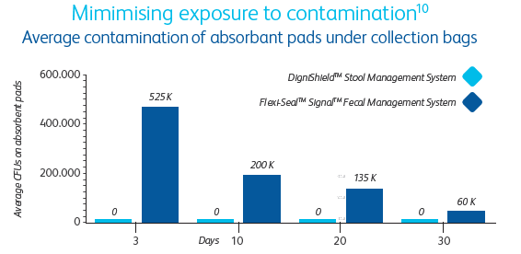
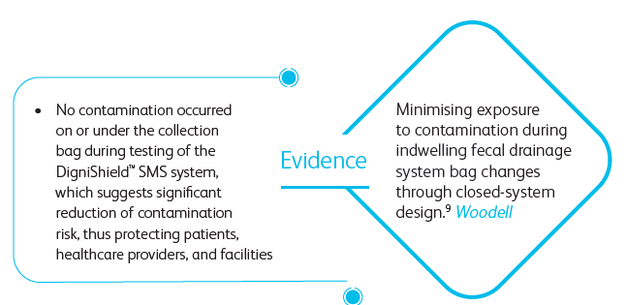
DigniShield Stool Management System – Evidence

Slide 26
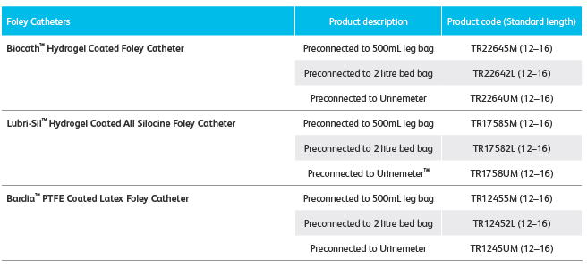
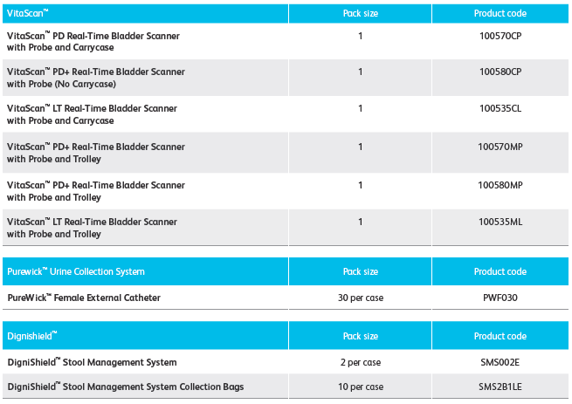

Ordering Information

