Slide 1
HAIs & CAUTI

Slide 2
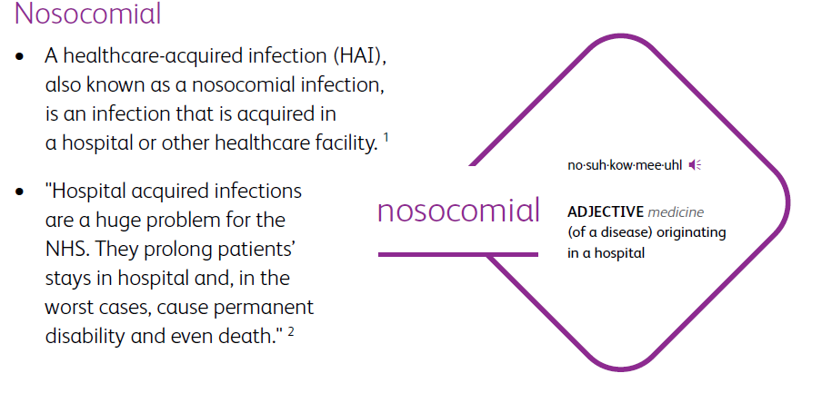
Healthcare Acquired Infections

Slide 3
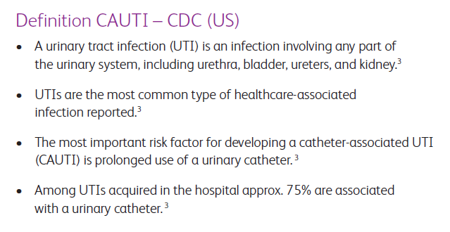
CAUTI

Slide 4
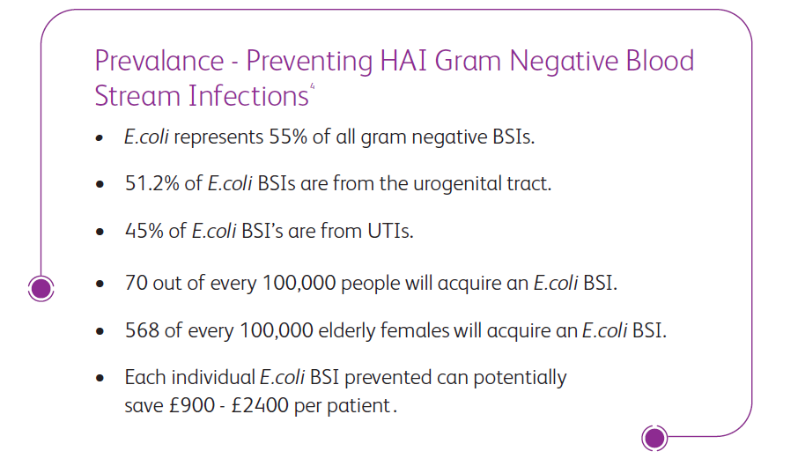
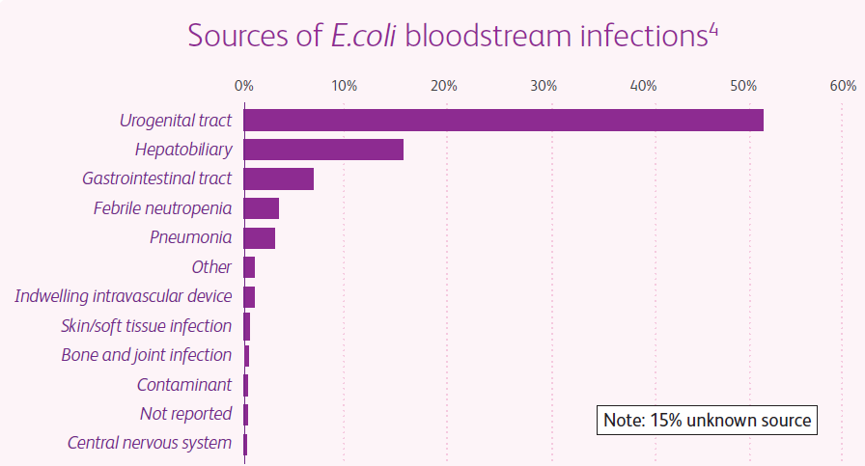
CAUTI and Gram Negative Blood Stream Infections

Slide 5
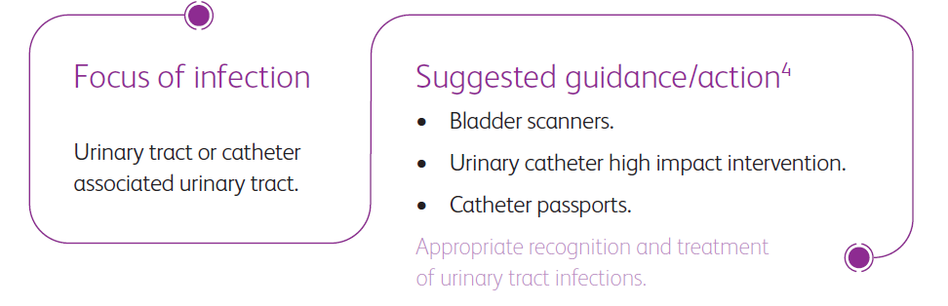
CAUTI and Gram Negative Blood Stream Infections

Slide 6

Key Insights And Guidelines

Slide 7
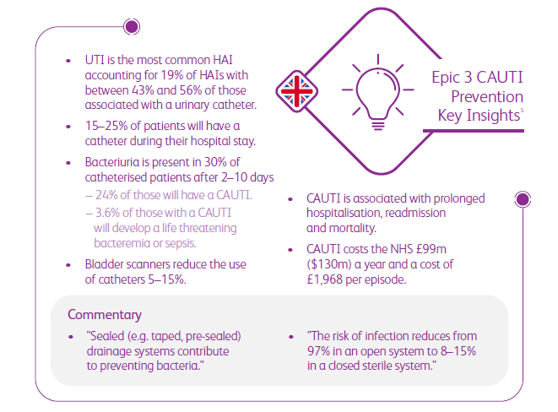
EPIC 3

Slide 8
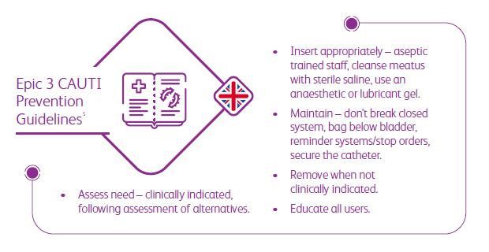
EPIC 3

Slide 9
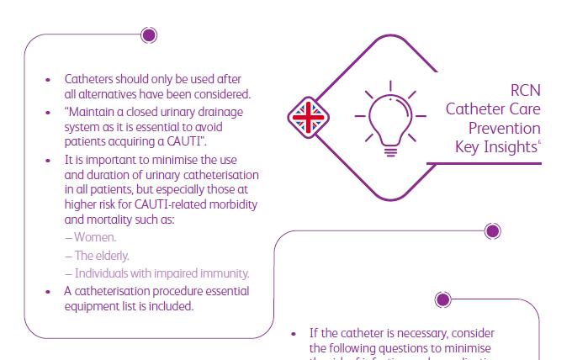
RCN Catheter Care Guidelines

Slide 10
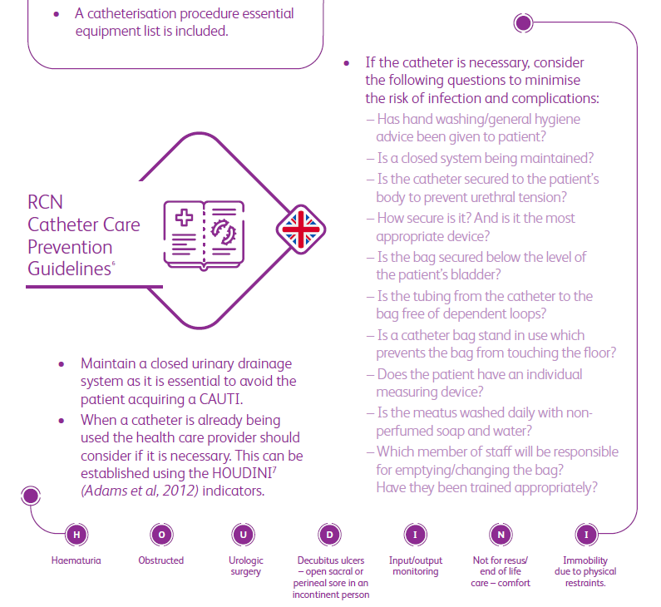
RCN Catheter Care Guidelines

Slide 11
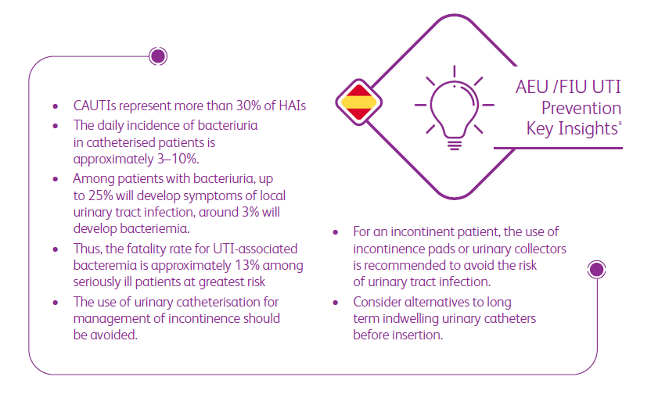
AEU / FIU Guidelines

Slide 12
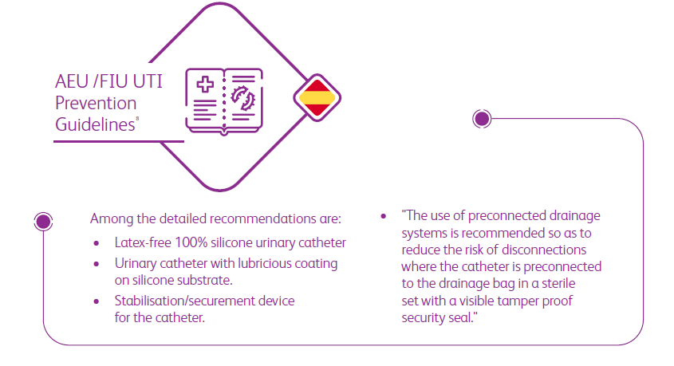
AEU / FIU Guidelines

Slide 13
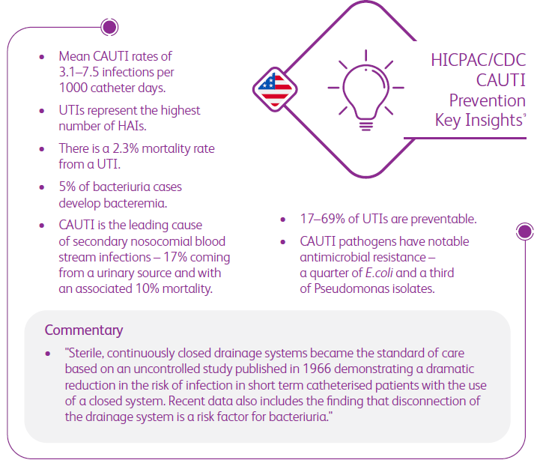
HICPAC/CDC

Slide 14
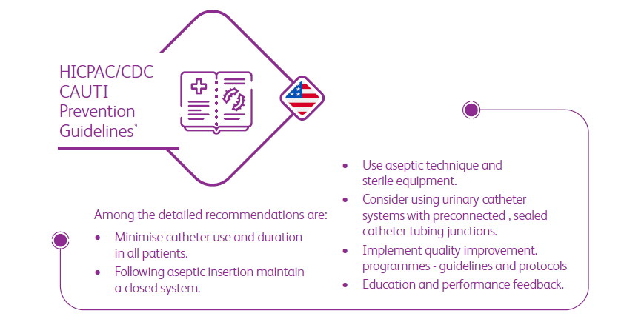
HICPAC/CDC

Slide 15
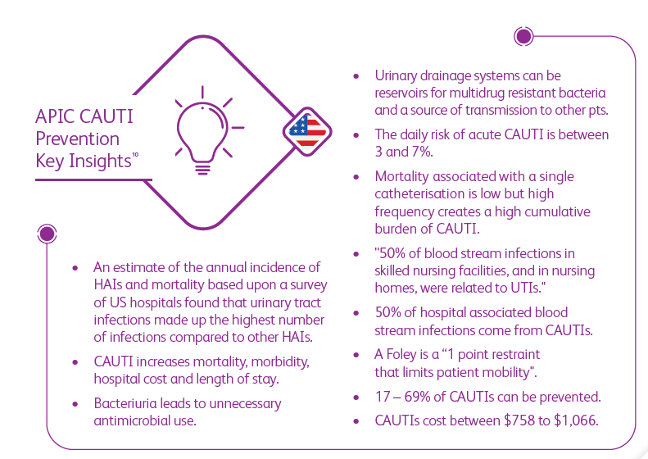
APIC

Slide 16
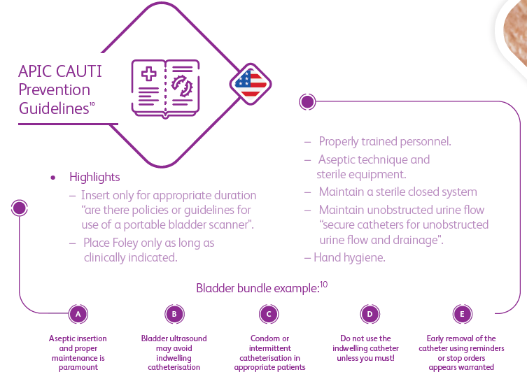
APIC

Slide 17


